Slide 1
Introduction to keras
CSE-4625 Sabah Binte Noor
Assistant Professor
CSE, DUET

Slide 2
Keras
A deep-learning framework for Python that provides a convenient way to define and train almost any kind of deep-learning model.
Initially developed for researchers, with the aim of enabling fast experimentation.

Slide 3
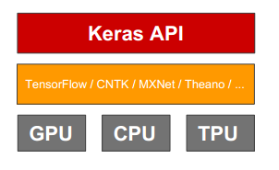
Keras
An API for specifying & training differentiable programs

Slide 4
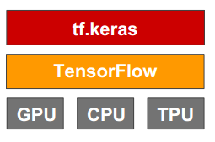
Keras is the official high-level API of TensorFlow
tensorflow.keras (tf.keras) module
Part of core TensorFlow since v1.4
Full Keras API
Better optimized for TF
Better integration with TF-specific features
Estimator API
Eager execution
etc

Slide 5

Who makes Keras?

Slide 6
What’s special about Keras?
A focus on user experience.
Large adoption in the industry and research community.
Multi-backend, multi-platform.
Easy productization of models.

Slide 7
Keras Developer
250,000

Slide 8
Year-0n-year growth
> 2x

Slide 9

Industry traction

Slide 10
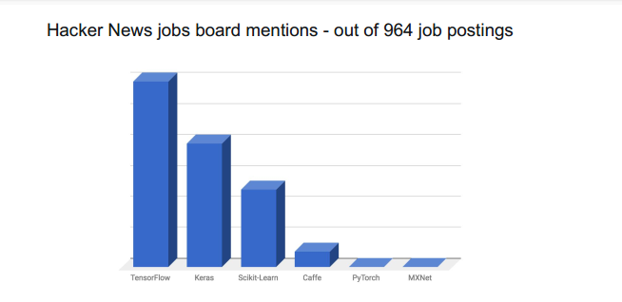
Startup-land traction

Slide 11
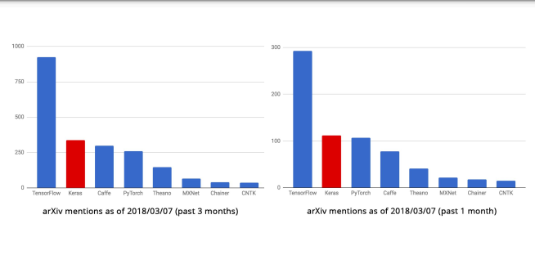
Research traction

Slide 12
My First Keras Project
import tensorflow as tf
mnist = tf.keras.datasets.mnist
(x_train, y_train),(x_test, y_test) = mnist.load_data()
x_train = tf.keras.utils.normalize(x_train, axis=1)
x_test = tf.keras.utils.normalize(x_test, axis=1)
model = tf.keras.models.Sequential()
model.add(tf.keras.layers.Flatten()) model.add(tf.keras.layers.Dense(128, activation=tf.nn.relu))
model.add(tf.keras.layers.Dense(128, activation=tf.nn.relu))
model.add(tf.keras.layers.Dense(10, activation=tf.nn.softmax))
model.compile(optimizer='adam',
loss='sparse_categorical_crossentropy',
metrics=['accuracy'])
model.fit(x_train, y_train, epochs=3)
val_loss, val_acc = model.evaluate(x_test, y_test)
print(val_loss)
print(val_acc)

Slide 13
REference
‘Deep Learning with Python’- FRANÇOIS CHOLLET
https://web.stanford.edu/class/cs20si/lectures/march9guestlecture.pdf
https://pythonprogramming.net/introduction-deep-learning-python-tensorflow-keras/

